Slide 1
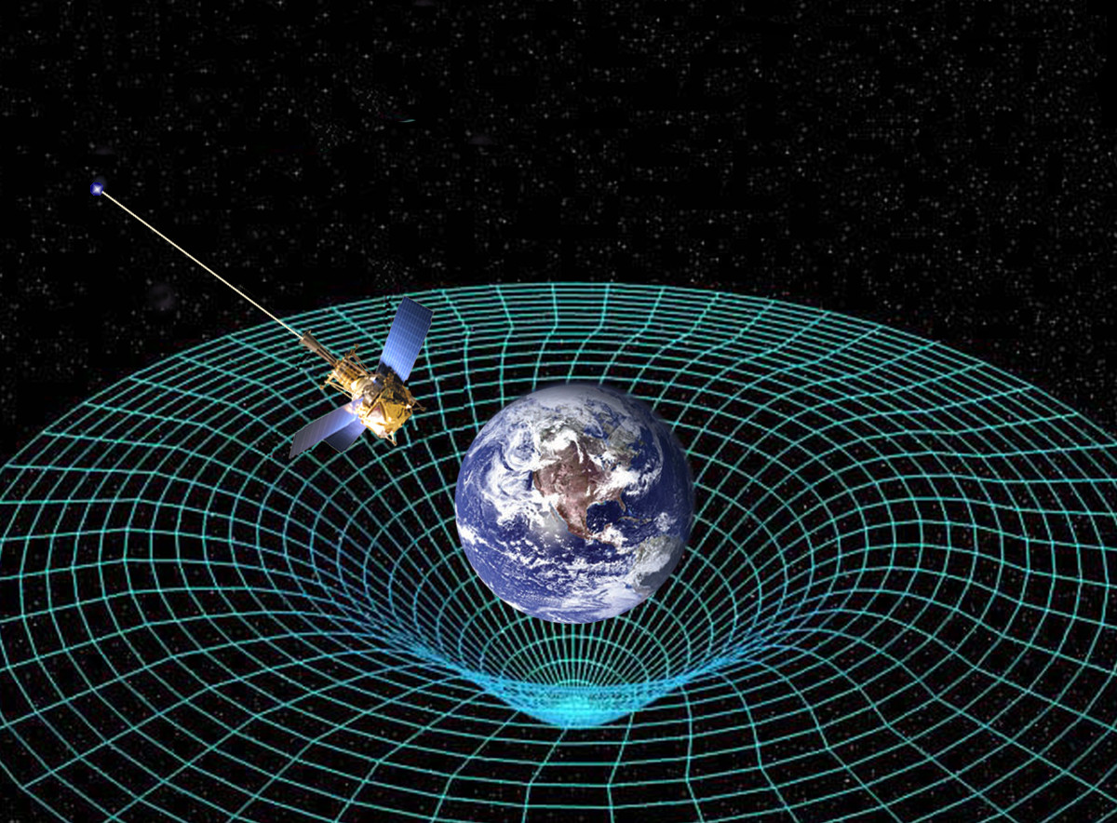
Gravitational Forces
Cornell Notes
This Photo by Unknown Author is licensed under CC BY-SA

Slide 2
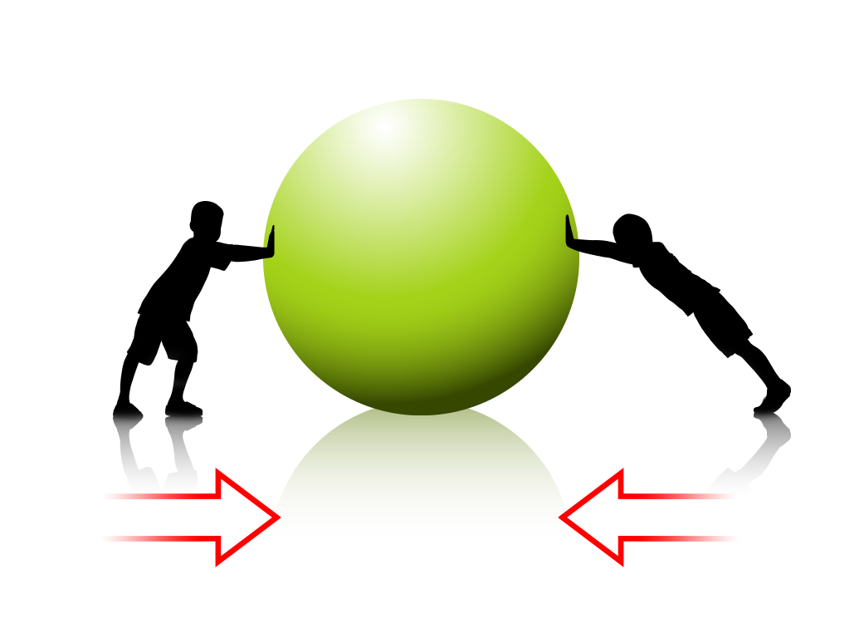
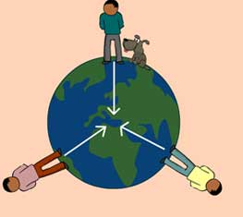
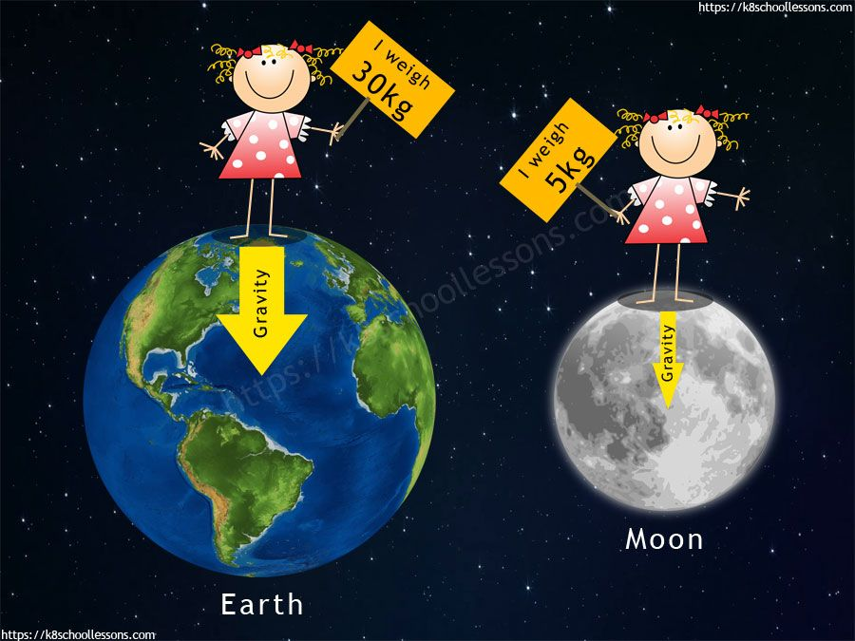
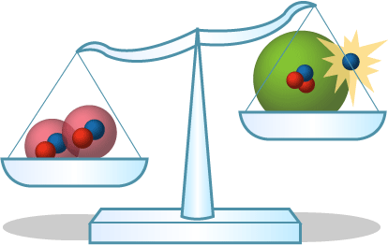
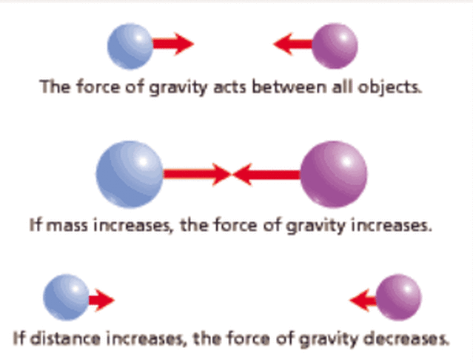
Picture Vocabulary
Word | Picture | Definition
Attractive
Force
Gravity
Interacting Objects
Mass
Weight

Slide 3
Mass vs. Weight
Questions | Answers
1. How is weight different from mass?
a. Which one never changes?
b. What are the units used for mass and weight?
c. Is the following sentence true or false? | On the moon, your mass would be the same, but your weight would be different.
d. Why is it that you weight more on Earth than you would on the Moon?

Slide 4
Gravity
Questions | Answers
1. What does the Law of Gravity state?
a. Who came up with the Law of Gravity?
b. What 2 factors determine how strong gravity is?
c. Fill-in-the-blanks: | If distance increases, the force of gravity _____________. If mass increases, the force of gravity _____________.
d. Is the following sentence true or false? | The force that makes an apple fall to the ground is the same force that keeps Earth orbiting the Sun.

Slide 5
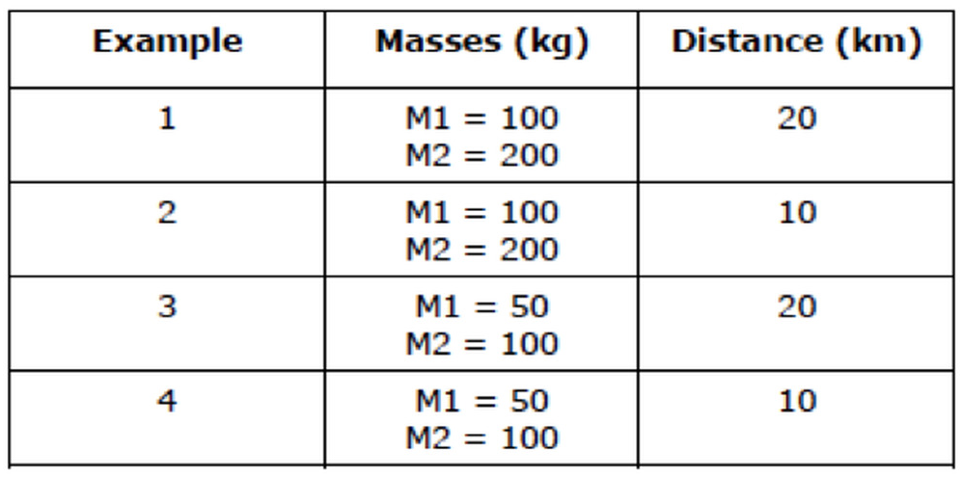
Conclusions
Question: | Answer:
The table above shows four examples of pairs of objects, their masses, and the distance between them. In which example is the gravitational force of attraction between the two objects the greatest? Provide reasoning to support your choice.

