Slide 1
Unit 1 Lesson 11
Practice Problems

Slide 3
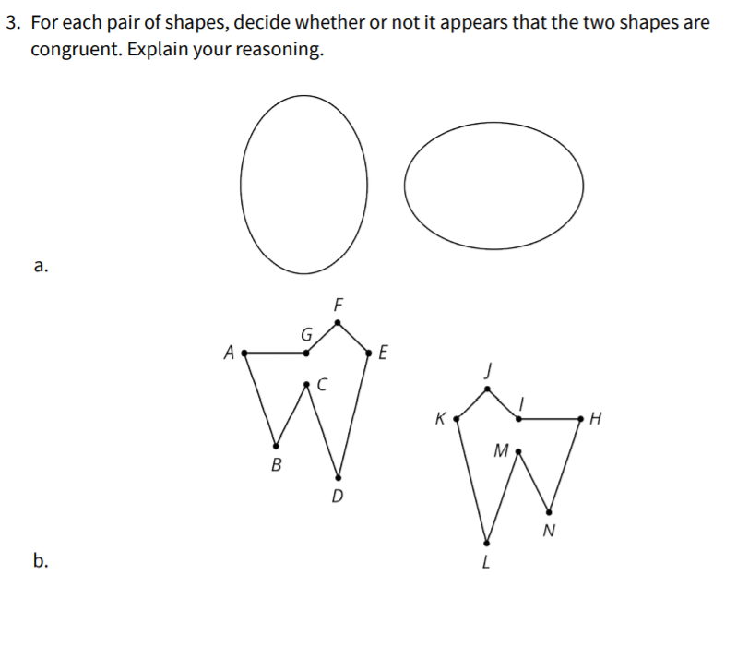

Slide 4
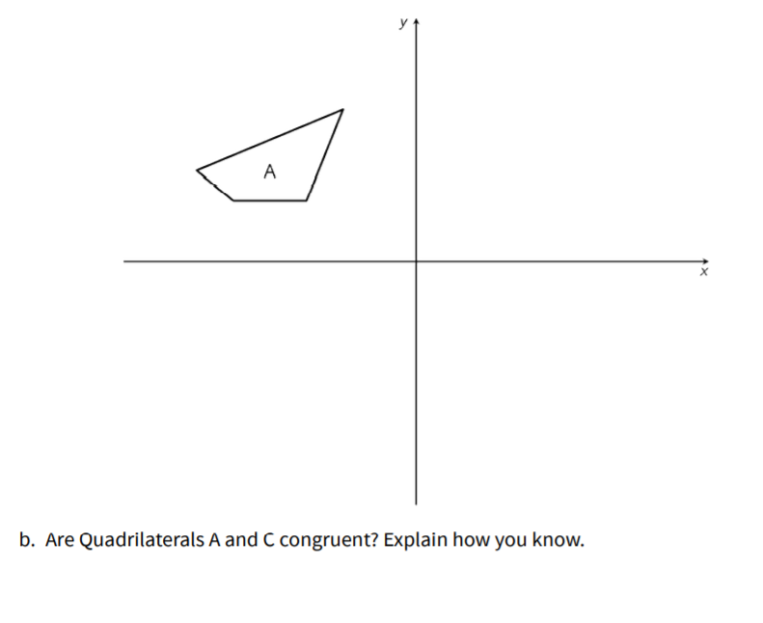

Slide 6
